Slide 1
COMP 3617
Week 8

Slide 2
Agenda
Threads in Android
Networking in Android

Slide 3
Multithreading in Java
Multithreading enables better performance and responsiveness of the user interface
A thread in Java is implemented via java.lang.Thread
Basic execution unit in Java
Thread starts and exits when the task performed by the thread is finished
In Java Runnable interface implementations are another abstraction over threads

Slide 4
Multithreading in Java
Android apps also adhere to the threading model built into the Java language
It is assumed that you have some familiarity with Java threading API
If you are not familiar with the terms – synchronization, monitors, locks, executors, pick up a Java Programming language book and brush up the basics of Java threads and concurrency

Slide 5
Threads in Android
When an app is launched the system creates a thread of execution for the app called “main”
This thread is responsible for dispatching events (clicks, swipes etc) to the UI elements
It is typically called the UI thread
In addition, Android runs all components in the UI thread
If you need to perform a long running operation in response to user interaction, then that operation can tie up the UI thread

Slide 6
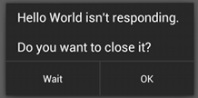
Threads in Android
Results in a poor user experience and performance for the app
If the UI thread is performing long running operations, the app becomes unresponsive to the user
Android prevents this scenario by intervening to display the “application not responding” ANR dialog

Slide 7
Threads in Android
Android allows the user to force quit the application via the ANR dialog
If the UI thread is blocked for more than a few seconds (currently 5), the user is prevented with the ANR dialog
To resolve this issue, the long running task can be off loaded to a worker thread specifically created for that purpose
But once the task is done and it might need to update the UI to provide feedback

Slide 8
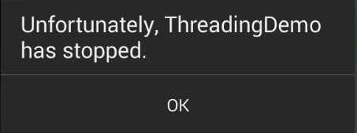
Threads in Android
When the worker thread updates the UI element (say a TextView), the app crashes
This is because the Android UI toolkit is not thread-safe
This means the UI elements can only be updated via the UI thread and not from the worker thread

Slide 9
Threads in Android
One way to update the UI from the worker threads is via a call to Activity.runOnUiThread() which takes in a Runnable instance
Alternatively each view has a post() and postDelayed() methods that can be used to update the UI elements from the worker thread
But using the above models work for simple apps but very quickly the complexity of app can make such code complex and unmaintainable

Slide 10
AsyncTask
Class in Android that performs background operations and publishes results on the UI thread without manipulating threads
Handles the two challenges we discussed in the earlier slides – ANR and handling the single threaded access to UI elements
An abstract generic class that needs to be sub-classed in order to make use of it
Ideally used for short operations (for a few seconds)

Slide 11
AsyncTask
Main Thread (t0)
Worker Thread (t1)
Start task on UI thread
Perform background task with optional updates
Update UI
Task Completed (May update UI)

Slide 12
AsyncTask Class
AsynTask is a generic type
AsyncTask<Params, Progress, Result>
Takes three parameters
Params – type of the parameters sent to the task for execution (think of this as inputs – for eg: if you are downloading files, they may be urls)
Progress – type of progress units published during the background operation
Result – type of the result for the background operation
If you don’t have specific types, use Void

Slide 13
AsyncTask Class
There are three key methods
Method Name | Description
doInBackground(Params…) | Invoked on the background thread. Can take a long time.
onProgressUpdate(Progres…) | Invoked on the UI thread after a call to publishProgress. Used to display some form of progress to the user interface. If you don’t have anything to display, set Progress to Void and don’t override this method
onPostExecute(Result) | Invoked on the UI thread after the background task finishes. Result of the operation is passed to this step as a parameter

Slide 14
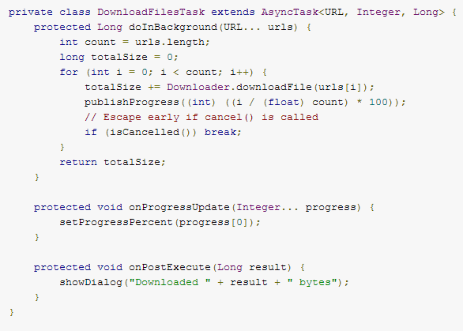

AsyncTask Class Usage
On the background thread
Performed on the UI thread
To kick off the task from the main activity

Slide 15
Alternatives to AsyncTask
To run something on the main application thread you can make use of post() on any View or runOnUiThread() on Activity
Handlers and HandlerThreads can also be used (Advanced Topic)
Executors in the Java concurrency framework can also be leveraged
Next week we will look at a component in Android to enable background long running tasks

Slide 16
Android Networking
As Android is based on Linux kernel there are a number of networking capabilities
Apps have access to java.net package – which provides networking related classes
Both stream based and datagram sockets are supported
Package android.net has classes that help with network access beyond the normal java.net.* APIs
Package android.net.wifi enables managing Wi-Fi functionality on the device

Slide 17
Connecting to the Internet
Android apps typically use HTTP protocol to send and receive data
There are two main clients
HttpURLConnection
Apache Http Client
HttpURLConnection is a lightweight http client included in the Java runtime
Apache Http Client has significantly larger footprint
On older versions of Android (prior to 2.3) Apache Http client is recommended

Slide 18
Connecting to the Internet
HttpURLConnection is recommended on the newer versions of Android
Requires explicit access to the INTERNET in the manifest file of the app
Data from the internet can be any format – most common being JSON, XML, CSV, Text
Android apps can easily parse XML or JSON data
For XML Android provides a Pull Parser (streaming parser)
Notes:
You could also use the open source JDOM parser

Slide 19
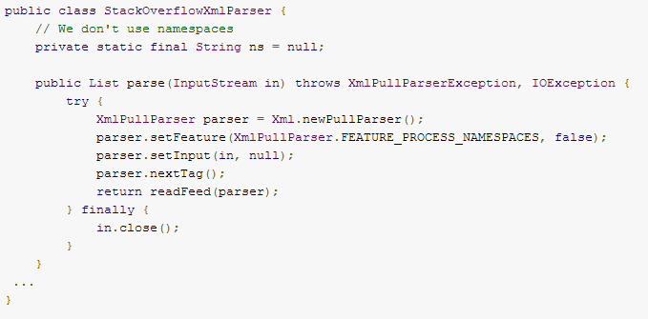
XML Parser
Sample Code is available at
http://developer.android.com/training/basics/network-ops/xml.html

Slide 20
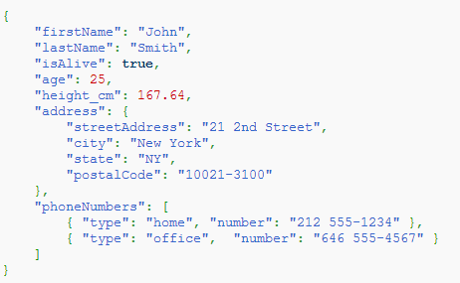
JSON
JavaScript Object Notation
Used to represent data in the form of attribute-value pairs
Language independent although originated in the JavaScript world

Slide 21
JSON
Data-interchange format
Human-readable collection of data
Capable of representing numbers, strings, booleans, null, arrays and objects
JSON has become more popular than XML after AJAX became common in web sites
Social media sites have adopted JSON as it allows for easy access to data from different domains
Android has support for JSON in org.json package

Slide 22
Note about Apache HttpClient
You will find a lot of online samples using the Apache Http Client library
Reasons why it is not recommended
Apache HttpClient is a separate open source project with its own releases and timelines. What is included in Android is an older version that was compatible with Android
Apache HttpClient is an extensive library compared to java.net implementation. Android team manages the java.net easily because of its limited capability

Slide 23
Note about Apache HttpClient
Bugs in java.net have been fixed making it suitable on newer Android versions

Slide 24
Alternatives Http Client Libraries
OkHttp
android-async-http
Volley (Available in the Android source but has not been made it to a library yet)
Picasso – specifically for downloading images

Slide 25
REST
Stands for Representation State Transfer
An architectural style for building apps
Client/Server – there is a client that requests services from the server
Stateless – Server does not hold context between requests
Has a uniform interface that is supported by 4 verbs typically – PUT, POST, GET and DELETE supporting CRUD functionality
REST typically uses HTTP as the protocol but can be extended to other protocols

Slide 26
Connecting to REST service
REST endpoints are based on HTTP protocol
Basic HttpURLConnection is sufficient to get and post data to the endpoints
REST endpoints can either serve JSON or XML data
JSON is popular for data transfer with Web 2.0 based apps and services
JSON data has JSON object and JSON arrays

Slide 27
Network Connections
Perform network operations on separate thread from user interface
Networks are unreliable
Provides better user experience
Make use of AsyncTask class for best performance
For multiple parallel transfers you can use custom executors

Slide 28
Managing Network Usage
If the app performs lot of network operations, provide a setting for the user to choose – Wi-Fi vs Mobile
A device can use various types of network connections
Use ConnectivityManager to check the network type before initiating a network op
Favor Wi-Fi over metered network
Common strategy is to fetch large data only if Wi-Fi is available

Slide 29
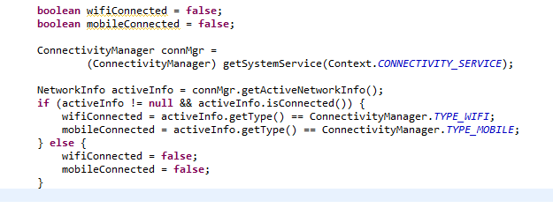
Network State
Get the ConnectivityManager service
Get the NetworkInfo instance
Query the NetworkInfo instance for Wifi or Mobile network

Slide 30
Best practices for Data Transfer
Prefetch data in a single burst over a single connection
Aggressive prefetching is bad as well
Recommended – prefetch data so you will only need to initiate another download every 2 to 5 mins in the order of 1 to 5 MB
Batch transfers by queieing delay tolerant transfers to limit the number of sessions
Reduce number of connections

